Slide 1



An Introduction to Intervener Microcredentials and National Intervener Certification E-Portfolio
The Paraprofessional Research & Resource (PAR²A) Center and
University of Colorado Denver

Slide 2
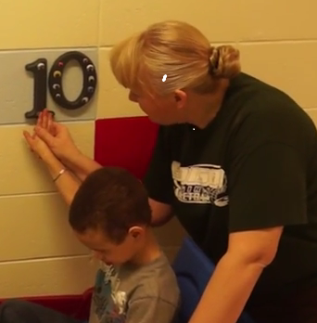
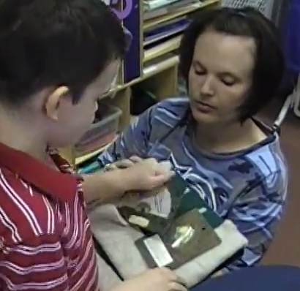
Introduction (cont.)
Interveners provide a key service, typically, in educational settings for students who are deaf-blind.

Slide 3
Introduction (cont.)
Interveners minimize the effects of multi-sensory deprivation and enable children to:
Become aware of what is occurring around them
Attach language and meaning to experience
Become empowered to have control over their lives
Sources: Henderson & Killoran, 1995; NCDB, 2012a

Slide 4

Introduction (cont.)
Increasingly, interveners also work in home and community settings with individuals of all ages.
Source: Wiley, et al., 2014

Slide 5
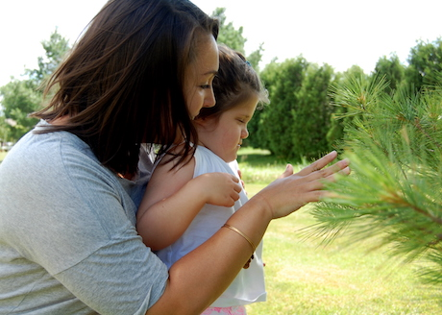
Introduction (cont.)
Despite the important role of interveners and the significant efforts made by families and professionals over the past three decades, support for intervener services remains fragmented and unevenly distributed across the country.
Source: NCDB, 2012a

Slide 6
Value of Intervener Microcredentialing and Certification
One effective way to increase the number of qualified interveners is by expanding the options for demonstrating competence through certification.
Offering more opportunities for intervener certification or credentialing will:
Raise awareness and encourage the use of interveners
Foster greater acceptance and recognition of the intervener practice
Ensure consistent training and acquisition of standardized knowledge and skill sets
Professionalize the role, establishing it as a recognized occupation
Source: NCDB, 2012

Slide 7
Value of Intervener Microcredentialing and Certification Continued
From a practical perspective, certification offers a means for:
Schools to identify interveners who have acquired a core set of essential knowledge and skills.
Interveners to demonstrate their proficiency in these knowledge and skills.
Interveners to enhance their abilities through self-reflection during the certification process.
Source: NCDB, 2012a

Slide 8
Background: Intervener Microcredentialing and Certification
From 2016 to 2023, the National Center on Deaf-Blindness (NCDB) implemented National Intervener Certification Eportfolio (NICE) in collaboration with the Paraprofessional Research and Resource Center (the PAR²A Center) at the University of Colorado Denver, state deaf-blind projects, practicing interveners, and university experts
In June 2025 the new version of intervener microcredentials leading to NICE certification is managed exclusively by the PAR²A Center at the University of Colorado, Denver.
The previous version of NICE has shifted from a single portfolio that covered all seven Council for Exceptional Intervener Standards to seven separate microcredential portfolios, each aligned with an individual CEC standard.

Slide 9
Alignment of Microcredentials and
CEC Intervener Standards
CEC Intervener Standards | Microcredential Titles
Standard 1: Engaging in Professional Learning and Practice within Ethical Guidelines | Microcredential #1 – Intervener: Professional Learning/Ethical Practice
Standard 2: Understanding and Addressing Each Individual’s Developmental and Learning Needs | Microcredential #2 – Intervener: Support for Individual’s Developmental and Learning Needs
Standard 3: Demonstrating Subject Matter Content and Specialized Curricular Knowledge | Microcredential #3- Intervener: Subject Matter Content and Curricular Knowledge
Standard 4: Using Assessment to Understand the Learner and the Learning Environment for Data-Based Decision Making | Microcredential #4 - Intervener: Assessing the Learner and Learning Environment
Standard 5: Supporting Learning Using Effective Instruction | Micro credential #5 - Intervener: Supports in Effective Instruction
Standard 6: Supporting Social, Emotional, and Behavioral Growth | Micro credential #6 - Intervener: Supports for Social, Emotional, and Behavioral Growth
Standard 7: Collaborating with Team Members | Micro credential #7 - Intervener: Collaboration with Team Members

Slide 10
Intervener Microcredentialing
Each microcredential is a portfolio on its own!
  The microcredential portfolio is a curated collection of artifacts representing their best work, showcasing their knowledge, skills, achievements, and experience aligned with each CEC Intervener Standard.
The PAR²A Center oversees the NICE Review Board and coordinates the review process.
The PAR²A Center relies on experts in deafblindness to evaluate artifacts/portfolios. All microcredential completion and certification decisions are made by the PAR²A Center based on an objective review process, and these determinations are final and not subject to appeal.

Slide 11

NICE Certification
Successful completion of all seven microcredentials leads to full NICE certification verifying that an intervener has acquired the foundational knowledge and skills necessary to support individuals who are deaf-blind in specific domains.
Microcredentials are are valid for 5 years.

Slide 12
Eligibility
Individuals eligible to apply for Intervener Microcredentials and NICE Full Certification include:
Practicing interveners and individuals who have completed intervener training. Formal training through a state deaf-blind project or university program is strongly encouraged, as applicants without formal training are unlikely to meet the portfolio requirements successfully.
Those who are currently serving, or have access to, a student or client with deaf-blindness, as the creation of required artifacts must involve documentation from direct work with a deaf-blind individual.

Slide 13
Overview of the Intervener Microcredential and Certification Steps
A simplified overview of the process is:
Review training materials
Meet with your mentor
Determine what microcredential you will be attempting
Register for the microcredential (s)
Download the NICE Microcredential Templates
Build your artifacts
Submit your artifacts for review

Slide 14
Review Process
The PAR²A Center oversees the NICE Review Board and coordinates the review process.
The PAR²A Center relies on experts in deafblindness to evaluate artifacts/portfolios. All microcredential completion and certification decisions are made by the PAR²A Center based on an objective review process, and these determinations are final and not subject to appeal.

Slide 15

Mentors
A crucial aspect of the NICE process is that each applicant must have a mentor who offers guidance and feedback throughout the development of their portfolio.
Ideally, this mentor is someone from the intervener’s home state with expertise in both deaf-blindness and the intervener’s role.
Research consistently highlights the significance of mentoring as a key factor in successful portfolio development.

Slide 16
Working with a Mentor

Slide 17
Working With a Mentor
Submitting your portfolio for a microcredential is a significant undertaking—but you won’t be doing it alone.
Your mentor will be there to guide and support you throughout the process. Here are a few ways they can help:
Engage in thoughtful conversation and offer encouragement as you review the NICE materials and CEC standards.
Help you clarify your goals and develop a realistic timeline
Provide ongoing feedback on the strengths and areas for improvement in your artifacts as you create them.
Review and offer suggestions for your “About Me” section.

Slide 18

Working With a Mentor (cont.)
Establish clear methods of communication with your mentor—such as phone calls, Skype, Google Hangouts, or in-person meetings.
At a minimum, mentors are required to meet with candidates at least three times, totaling a minimum of six hours of mentoring.
The next few slides outline the roles and responsibilities of both candidates and mentors to help you build a strong and effective working relationship. Review the handout Candidate-Mentor Relationship for further detail.
More about mentorship in Learning Activity 6: Effective Mentorship.

Slide 19
MENTORS
Qualifications/Role | Responsibilities | Relationship
Has training in deaf-blindness and is familiar with the intervener model Supports the candidate in understanding the CEC competencies and how they apply to the microcredentialing process. | Review and discuss the Intervener Microcredential Policy and Procedures and Candidate-Mentor Relationship with the candidate Assist in creating an e-portfolio development plan and timeline Hold regular meetings to monitor progress, offer feedback and encouragement | Adapt mentoring style to match the strengths and needs of the candidate Build a connection with the candidate Help the candidate “tell their story” their way

Slide 20
MENTORS (contd.)
Qualifications/Role | Responsibilities | Relationship
Encourages the candidate to engage in reflective self-assessment Models reflection by sharing relevant personal experiences | Communicates in ways that align with the candidate’s needs and preferences Notifies the candidate and relevant partners promptly if unable to provide agreed-upon mentoring Submits the Review Recommendation Form when the candidate is ready | Respects the candidate’s confidentiality, including their portfolio content Provides encouragement and professional support throughout the process

Slide 21
CANDIDATE
Qualifications/Role | Responsibilities | Relationship
Has received intervener training and is serving a student who is deaf-blind | Review and discuss the Intervener Microcredential Policy and Procedures and Candidate-Mentor Relationship with the mentor Create and share portfolio artifacts with your mentor and incorporate your mentor’s feedback Use the explanation prompt questions to guide conversations about artifacts | Is willing to be coached and open to constructive criticism as well as praise Professional and respectful of the mentor’s time and expertise

Slide 22
CANDIDATE (cont.)
Role | Responsibilities | Relationship
Engages in conversations with the mentor about all aspects of e-portfolio development | Take responsibility for the process and engage in reflective self-assessment Keep appointments and communicate any concerns or timeline/submission challenges with your mentor Maintain the confidentiality of your student or client | Is willing to be coached and open to constructive criticism as well as praise Professional and respectful of the mentor’s time and expertise

Slide 23
Getting Started with Your Mentor
Now that you have a basic understanding of the roles and responsibilities of both the mentor and candidate, it's time to complete two important forms:
Candidate Information Form
Mentor Information Form
These forms are designed to support clear communication and help build a strong, collaborative relationship between you and your mentor.

Slide 24
Verification of Mentorship
Before submitting the portfolio, candidates must complete the Review Recommendation Form, t to certify that they received mentorship.
This form also requires the mentor to confirm that they supported the candidate’s portfolio development in accordance with the ethical guidelines of their role.
You’ll learn more about this in Learning Activity 4: Portfolio Submission and Review.

Slide 25

For more information on Intervener Microcredentials and NICE certification, contact Dr. Ritu Chopra at the PAR²A Center
Ritu.Chopra@ucdenver.edu
https://paracenter.org/
Adapted from NICE Training Materials, 2017–2024. U.S. Department of Education Grant #H326T180026

Slide 26
What’s Next?
As you progress through the remaining learning activities,slide presentations and handouts in the training module, you will:
Explore the Council for Exceptional Children’s standards for measuring intervener competency
Learn how to create effective artifacts
Gain insight into the review process
Receive tips for successful mentoring

Slide 27
For more information on Intervener Microcredentials and NICE certification, contact Dr. Ritu Chopra at the PAR²A Center
Ritu.Chopra@ucdenver.edu
https://paracenter.org/
Adapted from NICE Training Materials, 2017–2024. U.S. Department of Education Grant #H326T180026

